Slide 1
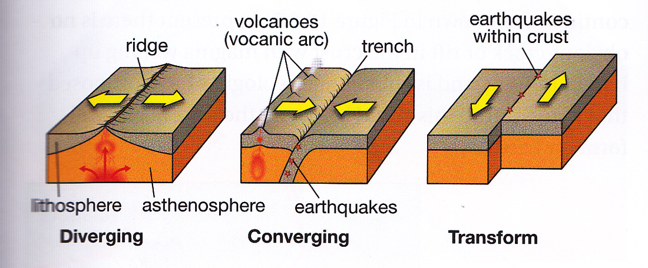
PLATE MOVEMENT

Slide 2
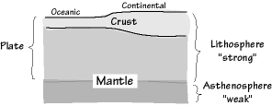
WHAT IS PLATE?
Plates are large pieces of the upper few hundred kilometers of Earth that move more or less as a single unit. It is easier to think of plates as rigid "rafts" floating on the mantle, but some plates also have some internal deformation. However, it is clear that the most active deformation of the plates occurs along their boundaries, where they interact with other plates
The precise thickness of a plate varies from place to place, but away from plate margins, plates are usually on the order of 100-200 km thick.
The precise lower boundary of a plate depends on the temperature of the mantle material. At about 1300°C typical mantle material begins to melt, and softens dramatically. We call that part of the mantle asthenosphere, to indicate that it is a weak zone, that "decouples" the plate from the overlying mantle (actually, there is undoubtedly some "drag" forces that act between the two, but the lithosphere can move independently of the deeper mantle.
The surface of the Earth is broken up into large plates. It’s easy to confuse these plates with the Earth’s crust – the thin outermost layer of the Earth. But there is more to the structure of the Earth than this simple image of a ‘cracked egg-shell’.
A massive, irregularly shaped slab of solid rock, generally composed of both continental and oceanic listhosphere

Slide 3
The earth’s layer’s can be defined in two different ways.
CHEMICAL COMPOSITION - 'CRUST' AND 'MANTLE
MECHANICAL PROPERTIES
-'LITHOSPHERE' AND 'ASTHENOSPHERE
crust - The crust is a thin but important zone where dry, hot rock from the deep Earth reacts with the water and oxygen of the surface, making new kinds of minerals and rocks. It's also where plate-tectonic activity mixes and scrambles these new rocks and injects them with chemically active fluids. Finally, the crust is the home of life, which exerts strong effects on rock chemistry and has its own systems of mineral recycling. All of the interesting and valuable variety in geology, from metal ores to thick beds of clay and stone, finds its home in the crust and nowhere else.
It should be noted that the Earth isn't the only planetary body with a crust. Venus, Mercury, Mars and the Earth's Moon have one as well (CONTENENTAL AND OCEANIC)
MANTLE The Earth is dynamic thanks to its internal heat, which comes from deep within the mantle from the breakdown of radioactive isotopes. This causes convection in the mantle – hot rocks rise and cold rocks descend. This very slow motion in the solid state transfers stresses to the lithosphere, just as convection in a boiling pan of thick soup will cause the skin to buckle where the convection cells meet. The mantle is the mostly-solid bulk of Earth’s interior. The mantle lies between Earth’s dense, super-heated core and its thin outer layer, the crust. The mantle is about 2,900 kilometers (1,802 miles) thick, and makes up a whopping 84% of Earth’s total volume.
'
lithosphere - The lithosphere is the solid outer section of Earth, which includes Earth's crust (the "skin" of rock on the outer layer of planet Earth), as well as the underlying cool, dense, and rigid upper part of the upper mantle. The lithosphere extends from the surface of Earth to a depth of about 44–62 mi (70–100 km). It is bounded by the atmosphere above and the asthenosphere (another part of the upper mantle)
ASTHENOSPHERE - The asthenosphere is the highly viscous, mechanically weak and ductilelydeforming region of the upper mantle of the Earth. It lies below the lithosphere, at depths between approximately 80 and 200 km (50 and 120 miles) below the surface. TheLithosphere-Asthenosphere boundary is usually referred to as LAB. The asthenosphere is almost solid, although some of its regions could be molten.

Slide 4
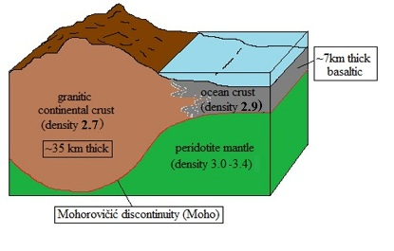
CHEMICAL COMPOSITION
- 'CRUST' AND 'MANTLE'
The surface of the Earth is the top of the 'crust' - whether one is under the sea or on land! By and large, the portions of the crust that poke above the sea to form land consist of 'continental crust'. If you were to drill into this, you would find rock with an overall composition similar to granite - a rock rich in the minerals feldspar and quartz (aluminium and silicon).
Continental crust is thick - but after about 35 km of drilling, you would finally come to a different layer with a different chemical composition at a boundary called the Mohorovicic Discontinuity or Moho (named for the Croatian seismologist who discovered it). Below this boundary the rock changes to one rich in iron and magnesium, and the main rock type is called peridotite. This rock is characteristic of the upper parts of the Earth's mantle.
If you were to take a drillship and drill through the crust of the ocean floor, however, you would encounter a very different type of rock. Oceanic crust is made of a rock called basalt, which is darker and more dense than continental crust. You would only have to drill for about 7 km before crossing the Moho and entering the upper mantle.
Below the Moho, the mantle extends to the surface of the Earth's

Slide 5
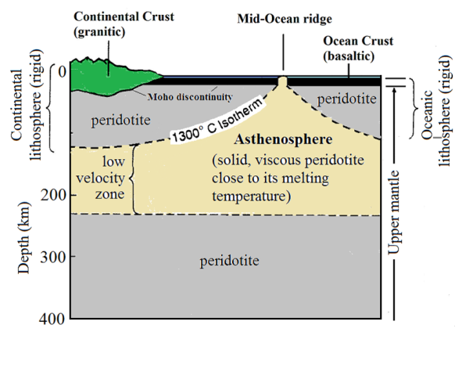
MECHANICAL PROPERTIES - 'LITHOSPHERE' AND 'ASTHENOSPHERE'
We may think we know what we mean by the Earth's 'tectonic plates', but there is more to a tectonic plate than just 'crust'. A clue to this may be found in the other name for 'tectonic plate', which is 'lithospheric plate'.
It is not just the chemistry of rocks that may change with depth - their mechanical properties also change, according to pressure and temperature. Both factors affect rock's mechanical strength, whatever its chemical composition
As temperatures rise with depth, rocks reach temperatures that would cause them to melt if they were at the surface. The rocks remain solid at depth despite their temperature because of the extreme pressures acting upon them. However, they do become plastic. Subjected to immense forces, and with vast amounts of time, such rocks will flow.
Some substances display this property of solid creep even at the surface. Think, for example, of chocolate, which in a warm room may flow and deform without melting. Substances like plasticine (potty putty) will also flow under gravity, especially when warm. Pitch, used for roads, can be brittle when struck with a hammer, but still flow very slowly, just as ice does when a glacier moves downhill.
The temperature gradient of the Earth means that, at a certain depth in the upper mantle, peridotite will behave like this too. This occurs when peridotite reaches 1300ºC and gives rise to a layer called the asthenosphere, where the rock is weaker than both overlying and underlying mantle.
The rocks above the asthenosphere, being the uppermost mantle plus the overlying crust (either continental or oceanic) behave mechanically as one, and comprise what geologists call the 'lithosphere'. The lithosphere moves as one over the weaker, plastic asthenosphere.
So, to a geologist the outermost shell of the Earth is the lithosphere, which is partly made of crust and partly upper mantle (as defined by its composition), but which mechanically moves as a single unit.
Lithospheric plates (continental and oceanic)
above the asthenosphere

Slide 6
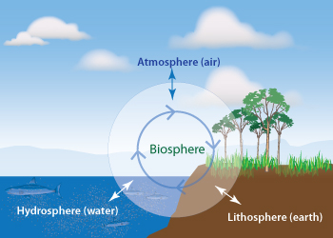
EARTH SPHERES

Slide 7
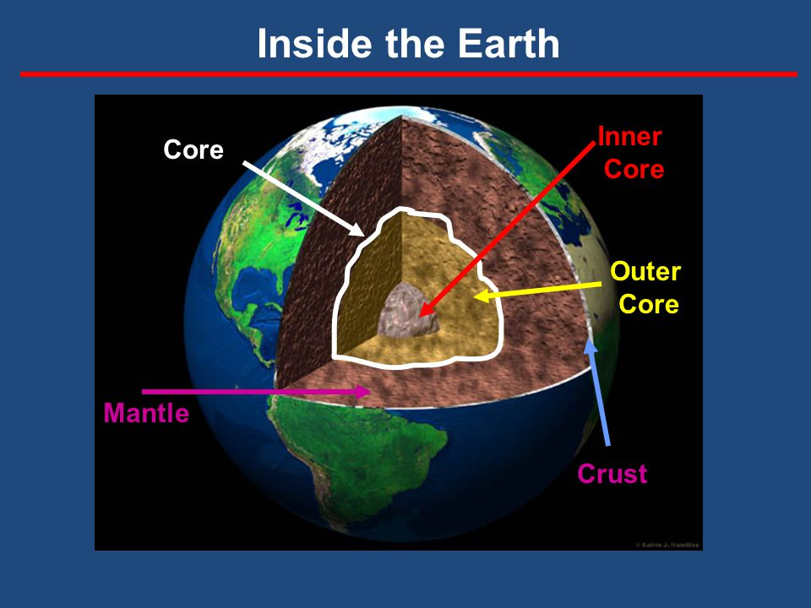
LAYERS OF THE INSIDE EARTH

Slide 8
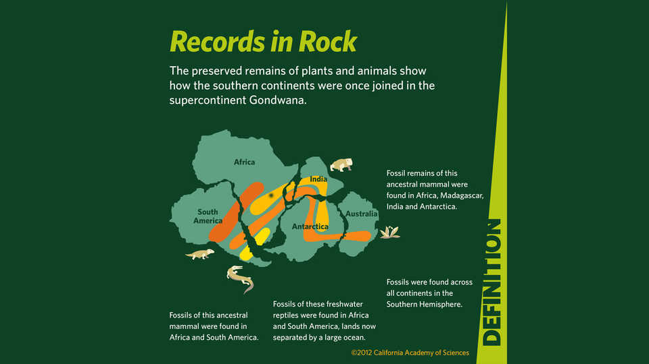
PLATE TECTONIC THEORY
Modern continents hold clues to their distant past. Evidence from fossils, glaciers, and complementary coastlines helps reveal how the plates once fit together.
Fossils tell us when and where plants and animals once existed. Some life "rode" on diverging plates, became isolated, and evolved into new species. Other life dispersed to new areas as continents reconnected, oceans narrowed, or chains of volcanic islands formed. Finding identical or similar fossils in areas separated by vast distances were some of the first clues that scientists used to reconstruct past plate movement. This distribution of fossils led to theories that the southern continents were once joined in a supercontinent called Gondwana.
Similar geologic formations on different continents show historic land connections. Antarctica’s mountains are an extension of South America’s Andes. If Southern Hemisphere continents were reassembled into a single landmass, glacial remnants in Africa and India would realign.
Fossils found in a big rocks located far apart
Magnetic field orientation in layers of rocks.

Slide 9
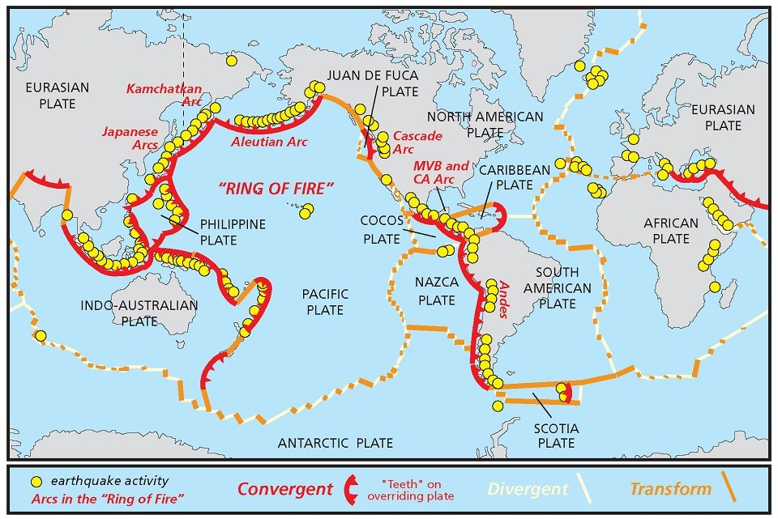
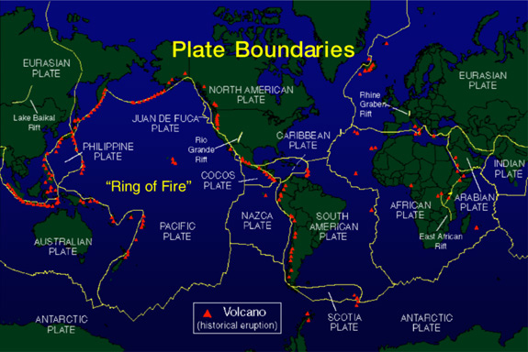
PLATES MAP

Slide 10
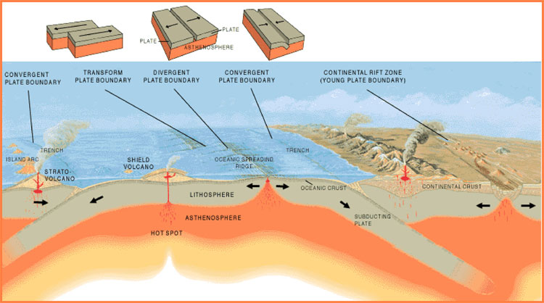
There are three kinds of plate tectonic boundaries: divergent, convergent, and transform plate boundaries.
A divergent boundary occurs when two tectonic plates move away from each other. Along these boundaries, lava spews from long fissures and geysers spurt superheated water. Frequent earthquakes strike along the rift. Beneath the rift, magma—molten rock—rises from the mantle. It oozes up into the gap and hardens into solid rock, forming new crust on the torn edges of the plates. Magma from the mantle solidifies into basalt, a dark, dense rock that underlies the ocean floor. Thus at divergent boundaries, oceanic crust, made of basalt, is created.
When two plates come together, it is known as a convergent boundary. The impact of the two colliding plates buckles the edge of one or both plates up into a rugged mountain range, and sometimes bends the other down into a deep seafloor trench. A chain of volcanoes often forms parallel to the boundary, to the mountain range, and to the trench. Powerful earthquakes shake a wide area on both sides of the boundary.
If one of the colliding plates is topped with oceanic crust, it is forced down into the mantle where it begins to melt. Magma rises into and through the other plate, solidifying into new crust. Magma formed from melting plates solidifies into granite, a light colored, low-density rock that makes up the continents. Thus at convergent boundaries, continental crust, made of granite, is created, and oceanic crust is destroyed.
Two plates sliding past each other forms a transform plate boundary. Natural or human-made structures that cross a transform boundary are offset—split into pieces and carried in opposite directions. Rocks that line the boundary are pulverized as the plates grind along, creating a linear fault valley or undersea canyon. As the plates alternately jam and jump against each other, earthquakes rattle through a wide boundary zone. In contrast to convergent and divergent boundaries, no magma is formed. Thus, crust is cracked and broken at transform margins, but is not created or destroyed.
Plate Boundary Zones
Tectonic plate boundaries that do not fall neatly into one of the above tectonic boundary types are called plate boundary zones. These boundary zones have plate movement deformation that occurs over a broad region, or belt. The Mediterranean-Alpine region between the Eurasian and African plates is a good example of a plate boundary zone. Here, several smaller fragments of plates, called microplates, have been discovered and described. These areas have complicated geological structures, such as volcano and earthquake zones, spread over a large region.

Slide 11
EARTHQUAKE

Slide 12
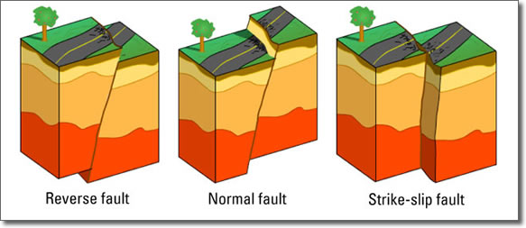
WHAT IS AN EARTHQUAKE?
a sudden and violent shaking of the ground, sometimes causing great destruction, as a result of movements within the earth's crust or volcanic action.
DIFFERENT TYPES OF AN EARTHQUAKE
A tectonic earthquake is one that occurs when the earth's crust breaks due to geological forces on rocks and adjoining plates that cause physical and chemical changes.
A volcanic earthquake is any earthquake that results from tectonic forces which occur in conjunction with volcanic activity.
A collapse earthquake are small earthquakes in underground caverns and mines that are caused by seismic waves produced from the explosion of rock on the surface.
An explosion earthquake is an earthquake that is the result of the detonation of a nuclear and/or chemical device.
WHAT IS A FAULT?
A fault is a planar fracture or discontinuity in a volume of rock, across which there ... Energy release associated with rapid movement on active faults is the cause of most earthquakes.
THREE TYPES OF FAULT
Normal faults form when the hanging wall drops down. The forces that create normal faults are pulling the sides apart, or extensional.
Reverse faults form when the hanging wall moves up. The forces creating reverse faults are compressional ,pushing the sides together.
Transcurrent or Strike-slip faults have walls that move sideways, not up or down

Slide 13
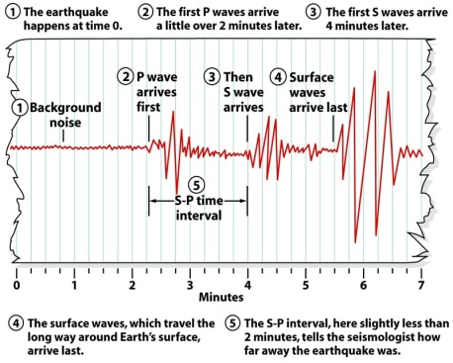

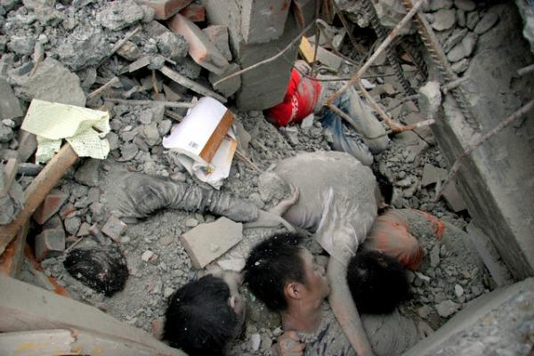
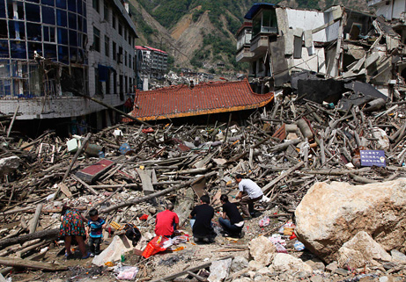
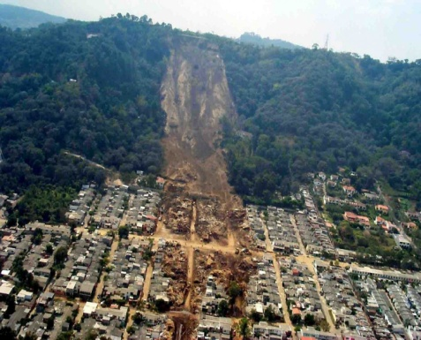
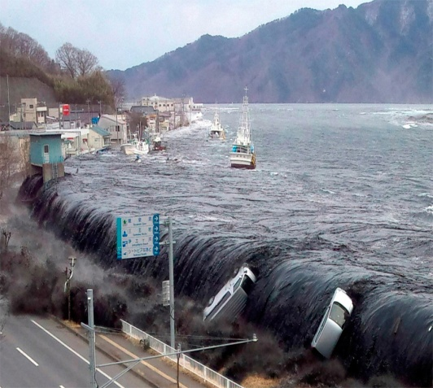
FACTS ABOUT EARTHQUAKE:
The damage caused by an earthquakes also depends on their depth and fault type.
Scientist use the different speeds of seismic waves to locate the epicenter.
Seismometer are used to measure the magnitude of an earthquakes
Earthquakes kill approximately thousands of people each year and have caused an estimated millions deaths in the past thousands of years.
Earthquakes are mostly caused by geological faults, but they can also be caused by landslides, nuclear testing, mine test, and volcanic activity.
An earthquake under the ocean can cause a tsunami, which travels outward in all directions up to 600 miles (970km) per hour, like the speed of a jet.

Slide 14
IS AN EARTHQUAKE DANGEROUS TO PEOPLE?
YES, it is.
Earthquake can be very dangerous , if you are in a wrong place. They can make buildings fall down and set off landslides, as well as having many deadly effects.
Earthquake can caused volcanoes activity.
It can kill thousands of people each appearance.
Road will break a part , trees will fall down.
Earthquake can also caused a tsunami from the ocean.

Slide 15
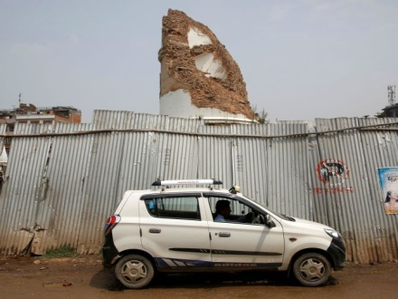
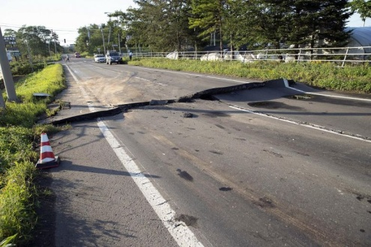
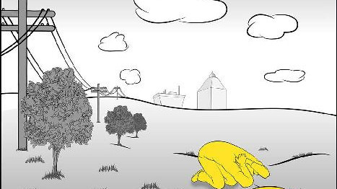

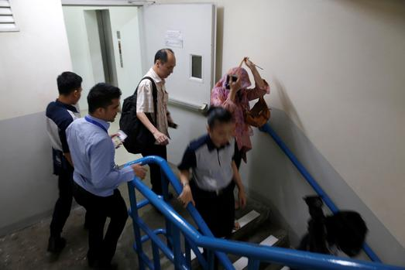
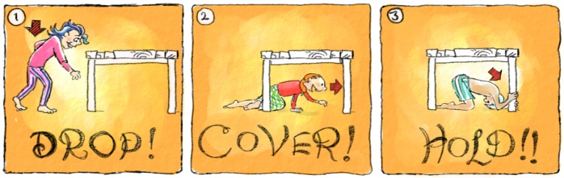
TIPS AND WAYS ON HOW TO SURVIVE DURING AN EARTHQUAKE.
METHOD: 1 *If you are in vehicle*
Stay seated in your car and wait until the earthquake is over.
Avoid roads, bridges, or ramps that might have been damage by an earthquake
METHOD: 2 *IF YOU ARE INSIDE THE BUILDING*
Steady yourself hold on to the solid object or get to the floor so that you do not fall.
DROP, COVER AND HOLD
Slowly and carefully leave the building.
METHOD: 3 *IF YOU ARE IN OUTDOORS*
Move away from buildings, street lights, power lines and anything else that could fall.
Things like cell phone are handy for every one , because if some one is injured, their should be one person can call for an ambulance or for help.

Slide 16
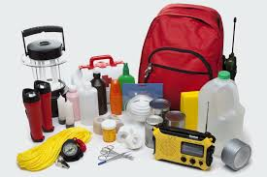
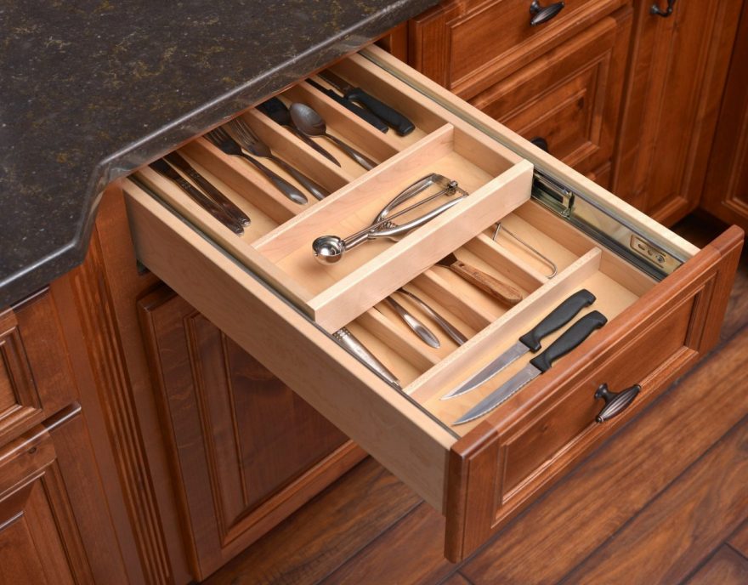
PREPARING FOR AN EARTHQUAKE
HAVE AN EMERGENCY SUPPLIES STOCKPILED*
TORCH, FLASHLIGHTS, FIRST AID KIT, MONEY, SIMPLE CLOTING, AND BLANKETS.
HAVE SURVIVAL PLAN OF YOUR HOUSE.
KEEP DANGEROUS OBJECTS IN A SECURED CABINET OR IN A LOWER SHELVES.

