Slide 1
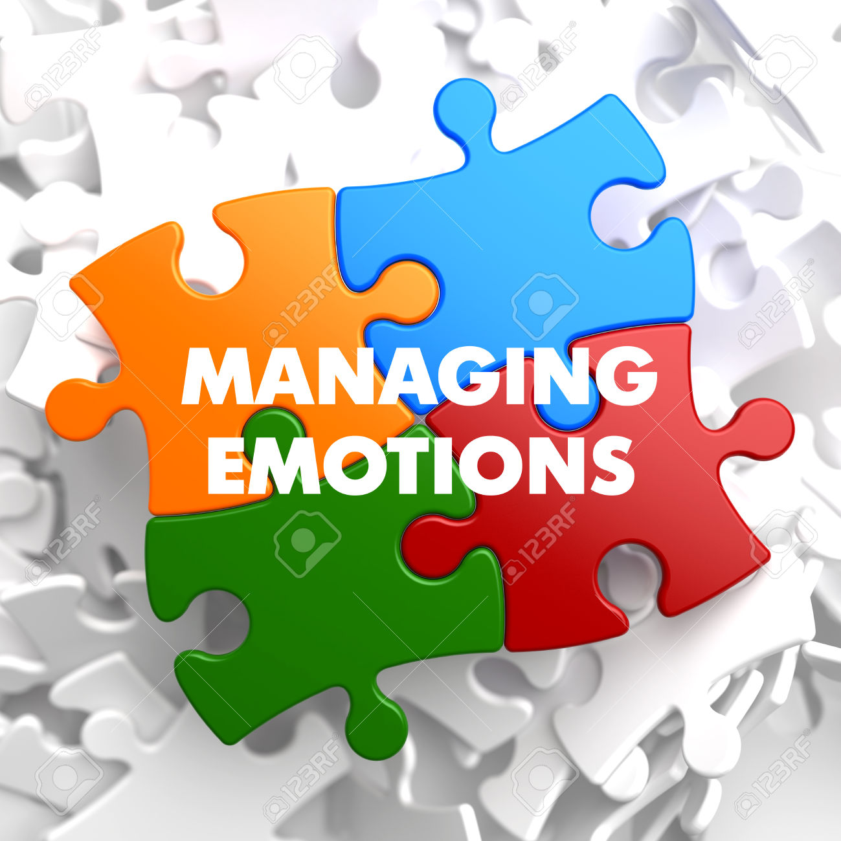
Managing Emotions and Impulses

Slide 2

Emotions
Energy in Motion.
are a vital part of our everyday lives.
a natural instinctive state of mind deriving from one's circumstances, mood, or relationships with others.

Slide 3
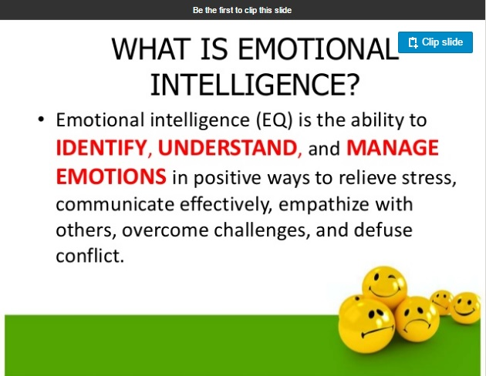
Emotional Intelligence ( EQ)

Slide 4
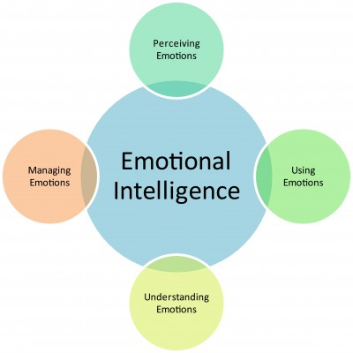


Slide 5
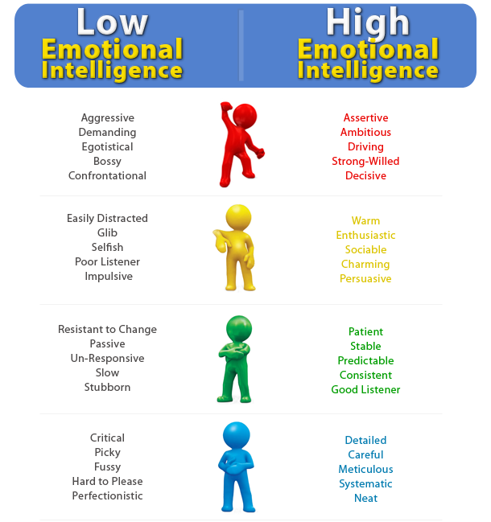

Slide 6

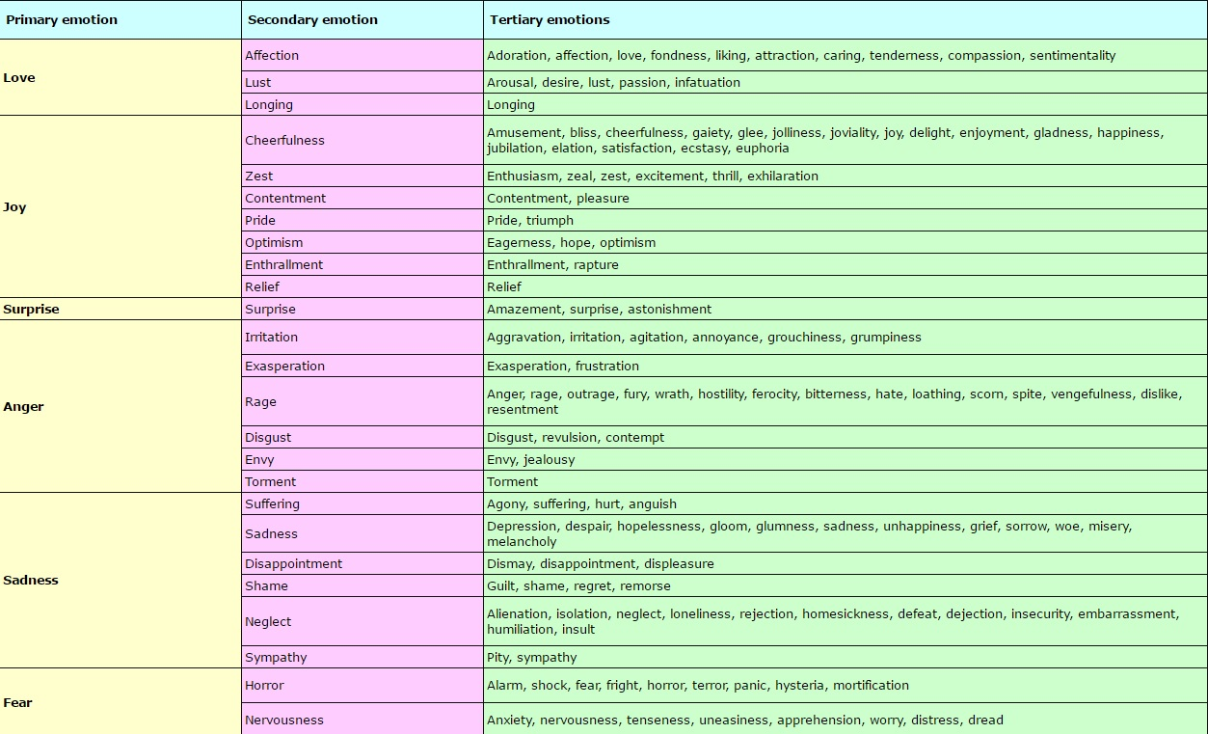
3 Structure of Emotions

Slide 7
Stop, Drop & Process
Techniques to Manage Your Emotions
You can develop a set of skills to help you better manage your emotions when the going gets rough.
The next time you're feeling strong emotions and you feel "hijacked" by those emotions, no longer cool and collected try SDP. It's especially important if you are concerned you might act in ways you'll later regret, or if you're not sure the best way to act in the situation.
With repeated practice, SDP can become a healthy habit for dealing with emotionally challenging situations.

Slide 8
1. STOP - Stop and think before you act!
If you're in a situation where your emotions are building to a point where you may have trouble maintaining control - stop!

Slide 9
Sometimes when we're feeling a strong emotion we act automatically (for example lashing out and insulting our partner when we feel hurt by him), without truly thinking about the consequences or the best way to approach the situation.
Learn how to identify the signs that you may be getting to this place.

Slide 10
2. DROP - Reduce the intensity of your emotions.
When we're feeling extremely strong emotions, it becomes very difficult for us to think clearly and rationally. Our bodies are in a "fight or flight" mode at that point (fight our way through the situation or run away), and neither of these options are very good in most relationship situations. Before you can begin to think through the situation rationally you're going to need to calm down.

Slide 11
1.Go outside - being outdoors decreases anxiety and increases mental clarity and focus.
2.Spend time with a pet - can significantly reduce the stress you're feeling.
3. Engage in a repetitive action like knitting, painting, or walking - any repetitive action can help you focus your attention calmly on the present.

Slide 12
4. Think about something that triggers a positive feeling - that could be the memory of being on your favorite beach, your grandmother's homemade bread, or that sense of accomplishment you feel after you've run 3 miles.
5.Breathe deeply - Concentrating on your abdomen, breathe in through your nose for a count of 5. Hold it briefly and then let the breathe out slowly and gently, focusing on the feeling of the air leaving your body. Repeat for 1-5 minutes.

Slide 13
3. PROCESS - Think about it.
Identify the specific emotions you are feeling. To manage emotions effectively you first need to be able to accurately identify those feelings.
Sometimes the surface emotions that we're feeling are masking other deeper, underlying emotions that are more difficult for us to deal with. So this step might involve some careful thought, in an environment where you feel safe working through these feelings.
Identify the source of those feelings

Slide 14
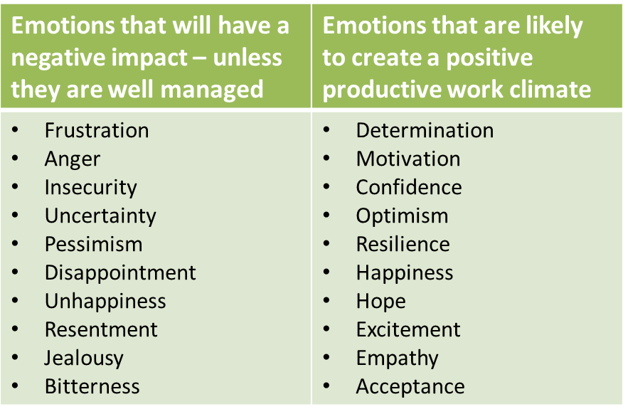

Slide 15
SIX steps to CONTROL YOUR EMOTIONS and regain rationality in any challenging situation:
control your emotions
Don’t react right away. Reacting immediately to emotional triggers can be an immense mistake. It is guaranteed that you’ll say or do something you’ll later regret. Before refuting the trigger with your emotional argument, take a deep breath and stabilize the overwhelming impulse. Continue to breathe deeply for five minutes, feeling as your muscles untense and your heart rate returns to normal. As you become calmer, affirm to yourself that this is only temporary.
Ask for divine guidance. Faith is our saving grace in our darkest moments. No matter your creed, developing a healthy relationship with the divine world will help you surmount your obstacles more easily. This is because when you believe in a higher force, you also believe in the power of divine intervention to show you what you must do, teach you why something is happening or even save you from a certain unwanted situation. When burdened with emotion, close your eyes, envision a positive solution to your problem, and ask the universe to illuminate the best path forward.

Slide 16
3. Find a healthy outlet. Now that you’ve managed your emotion, you’ll need to release it in a healthy way. Emotions should never be bottled up. Call or go see someone you trust and recount to them what happened. Hearing an opinion other than your own broadens your awareness. Keep a journal and transfer your emotions from your inner self onto the paper.
4. See the bigger picture. Every happening of our lives, whether good or bad, serves a higher purpose. Wisdom means being able to see past the moment and discern the greater meaning of any given situation. You may not understand it in the beginning, but as time goes by, you’ll begin to see the bigger picture falling into perfect order. Even in the midst of an emotionally upsetting moment, trust that there exists an ultimate purpose which you will come to comprehend soon.

Slide 17
5. Replace your thoughts. Negative emotions bind us to recurring negative thoughts, creating cycles of downright negative patterns. Whenever you are confronted with an emotion which is making you feel or think something bad, force it out of your mind and replace it with a different thought. Imagine the ideal resolution to your problem playing out, think about someone who makes you happy or remember an event that makes you smile.
6. Forgive your emotional triggers. Your emotional triggers may be your best friend, your family members, yourself or all of the above. You may feel a sudden wave of anger when your friend “does that thing she does,” or a stab of self-loathing when you remember something you could have done differently. But when you forgive, you detach. You detach from the resentment, the jealousy or the fury lingering within you. You allow people to be who they are without the need for escalating emotions. As you forgive, you will find yourself disassociating from the harsh feelings attached to your being.

Slide 18
How to Master Your Emotions
Emotions determine the quality of your life and emotions are contagious. Your ability to motivate and inspire the people around you will be enhanced by mastering your emotions.

Slide 19
Develop a positive emotions mindset by applying the following 7 key strategies.
1. Choose positive emotions every day: love, happiness, optimism, determination, confidence, gratitude, curiosity, passion, health, resilience.
2. Embrace negative emotions: anger, frustration, disappointment, fear, hurt, sadness, guilt, overwhelm, loneliness, inadequacy. Every emotion serves you if you take action. What else could this mean?
3. Own your emotions. You create your own emotions based on your interpretations. Choose commitment over hope.

Slide 20

Enhance your emotional intelligence by focusing on five key areas: mood, adaptability, stress management, interpersonal relationships and self-awareness.
4. Learn from emotions and move on. Don’t avoid and endure emotions.
5. Master emotions by moving.
6. Practice every day to develop a new success habit.
7. Develop your top 10 list of what makes you feel good.

Slide 21
I've learned that people will forget what you said, people will forget what you did, but people will never forget how you made them feel.
Maya Angelou

