Slide 1
Module 1
Personality Development

Slide 2

ACTIVITY #3.1

Slide 3
TOP 10 POSITIVE
AND NEGATIVE
QUALITIES/ ATTITUDES
OF YOUR SELF

Slide 4

Values
Thoughts
Personality
Beliefs
Role
Hopes and Dreams
Likes/ Dislikes
Feelings/ Emotions
Principles
Talents and Skills

Slide 5
Is having an insightful understanding of our personality, values, tendencies, need and beliefs.

Slide 6
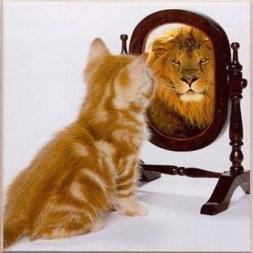
It is the process of analyzing our thoughts, beliefs, tendencies and emotions to help us determine our values and principles. Acting on this knowledge allows us to reach our FULLEST POTENTIAL and become SELF- ACTUALIZED.

Slide 7
Can be defined as the ability to perceive one’s own existence, including one’s own traits, feelings and behaviors
It is a persona understanding of one’s identity.

Slide 8
Is the foundation for personal change.
  Once an individual is aware of himself, once can be manage one’s behavior and function effectively.
  Ability to assess one’s personality, behaviors and skills accurately.
    Observing one’s own thoughts, behavior and skills.
    Comparing observations to an external source ( e.g. Standard or another person)

Slide 9
  To improve performance
    To manage yourself by setting appropriate goals, choose appropriate careers and manage stress.
    To accept your tendencies of behaving, thinking and feeling because 30% of personality is GENETIC.
  To develop intrapersonal skills
    Understanding differences between you and others
    Understanding why others react to you the wat they do.
  To develop interpersonal skills

Slide 10
Self-aware person is one who
Aware of Strength and limitations
Has a clear idea of one’s priorities
Aware of difference in attitudes, values and beliefs.
One has relatively stable and strong self- image and is not unduly perturbed by what others say about oneself.

Slide 11
Self-Awareness Process
-is about knowing and understanding
Your beliefs and principles
Your own emotions
What motivates you
Your thinking pattern
Your tendencies to react to certain situations
What you want out of your life.

Slide 12
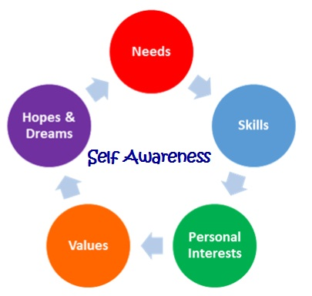

Slide 13
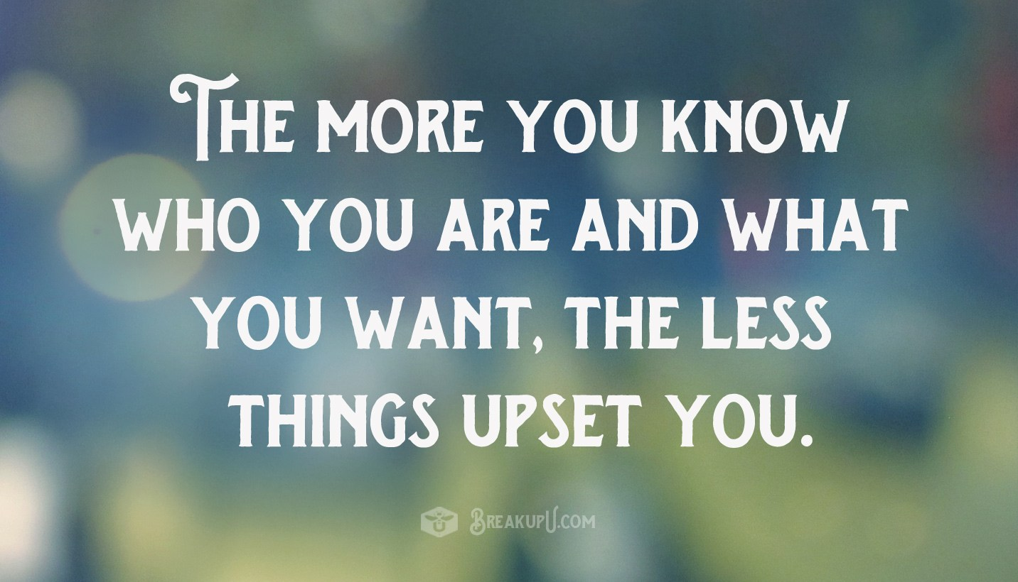

Slide 14
