Slide 1

Setting-Up Goal
(Self-Direction)

Slide 2
What is a GOAL?
Something you would like to achieve.

Slide 3
What is the purpose of Setting-up Goals?
Goals give you direction and keep you focused on where you want to end up.

Slide 4
2 Kinds of Goals
Short Term Goal
  Goals that can be accomplished in the near future ( within a few weeks or months)
Long Term Goals
  Goals that are more far-reaching and take longer to achieve (a year or more)

Slide 5
Why more people don’t set goal?
Fear of Rejection
Procastination
Low-self Esteem
Ignorance of importance of goals
Lock of Knowledge about goal-setting

Slide 6
Why do we need to set Goals?
Take control of your life.
Focus on important things.
Make Good decisions
Finish the task efficiently
Be self-confidents and enthusiastic
Make Progress
Closer to success

Slide 7
Why Goals fails?
The goals was not written down.
Rewards for achieving the goals were not given.
The goal was unrealistic or not specific enough.
The goal is not really believable or little commitment exist.
Keep changing or switching goals.
The person who set the goal has not told anyone else for added accountability, help and support.
The goal was not into realistic plan that includes measurement, timeliness and resources.

Slide 8
S-M-A-R-T
S-pecific
M-easurable
A-ttainable
R-ealistic
T-imebound

Slide 9
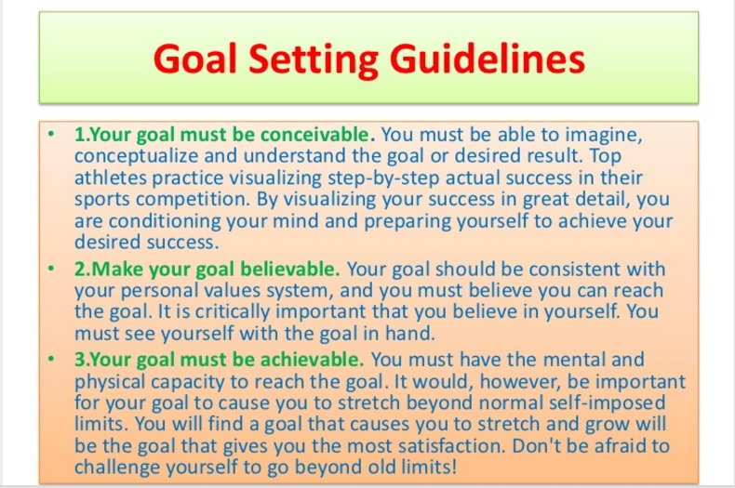

Slide 10
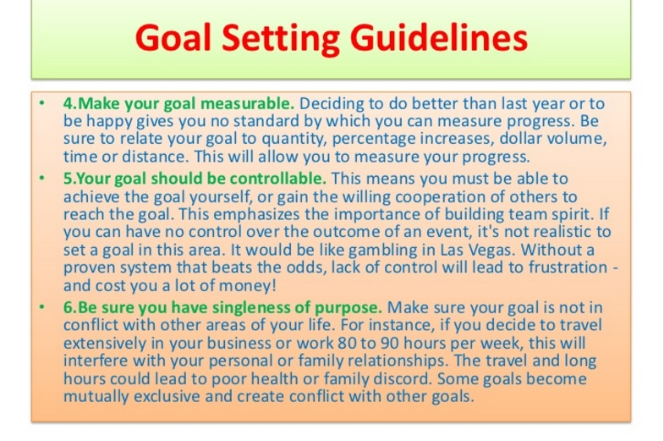

Slide 11


Slide 12



Slide 13


Slide 14


