Slide 1

PRESENTATION :
CONSTELLATION OF STARS AND ITS CHARACTERISTIC

Slide 2


An a video for us to know the history of our constellation.

Slide 3
CONSTELLATION
A group of stars forming a recognizable pattern that is traditionally named after its apparent form or identified with a mythological figure. Modern astronomers divide the sky into eighty-eight constellations with defined boundaries.

Slide 4

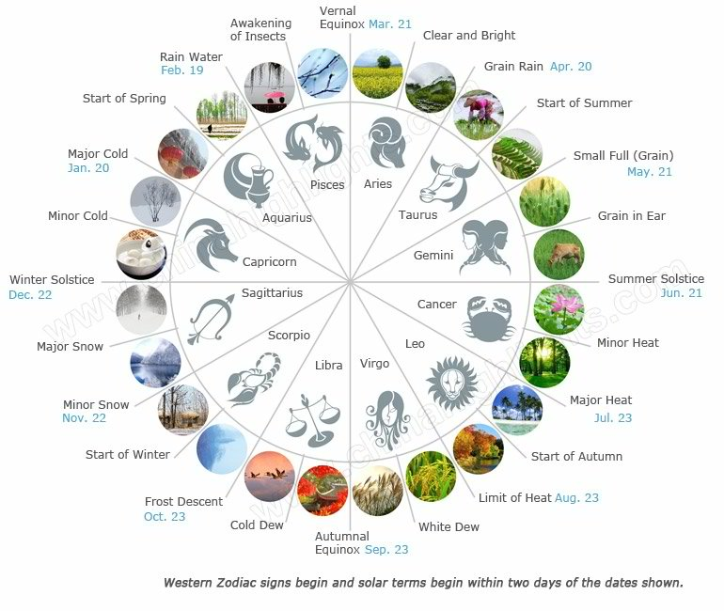
Zodiac signs

Slide 5
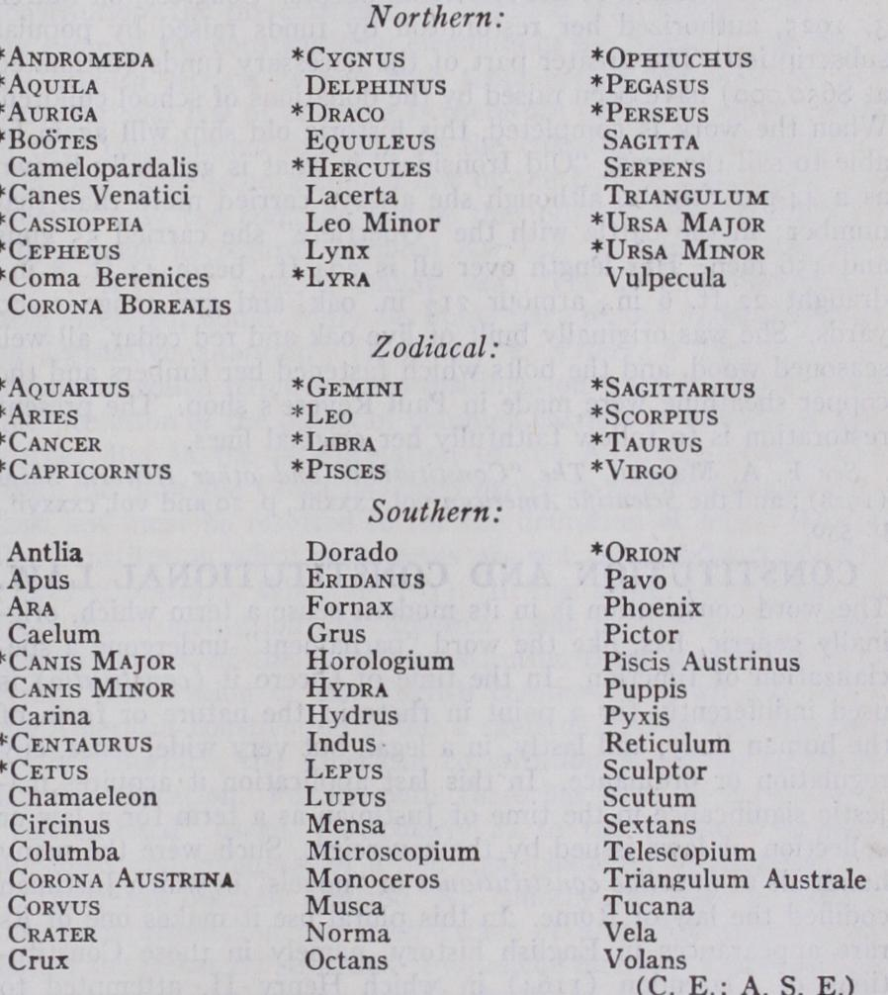
88 names of constellations

Slide 6

5 MAJOR CONSTELLATIONS

Slide 7

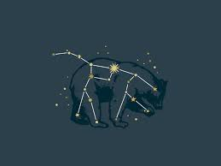
1.URSA MAJOR ‘GREAT BEAR’
Ursa Major is a constellation in the northern sky, whose associated mythology likely dates back into prehistory. Its Latin name means "greater she-bear", standing as a reference to and in direct contrast with nearby Ursa Minor, the lesser bear.

Slide 8

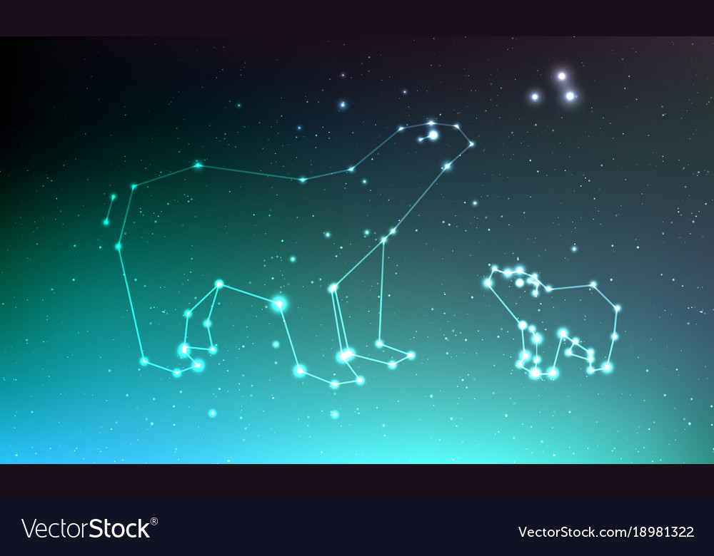
2.URSA MINOR ‘LITTLE BEAR’
Ursa Minor constellation lies in the northern sky. The constellation’s name means “the smaller bear,” or “the lesser bear,” in Latin.
The Great Bear constellation is represented by its larger neighbor Ursa Major. Ursa Minor was first catalogued by the Greek astronomer Ptolemy in the 2nd century. It is easy to recognize because it contains the famous Little Dipper asterism. Ursa Minor is also notable for marking the location of the north celestial pole, as it is home to Polaris, the North Star, which is located at the end of the dipper’s handle.

Slide 9

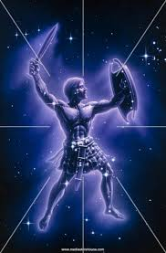
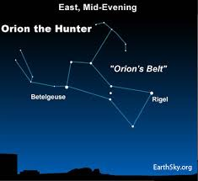
3.ORION ‘HUNTER’
Orion is a prominent constellation located on the celestial equator and visible throughout the world. It is one of the most conspicuous and recognizable constellations in the night sky. It was named after Orion, a hunter in Greek mythology.

Slide 10

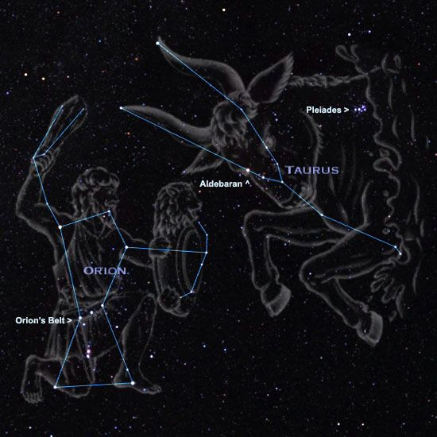
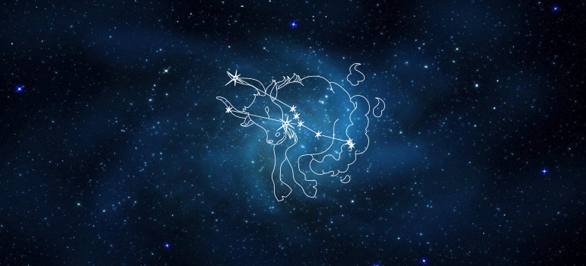
4.TAURUS ‘THE BULL’
Taurus is one of the constellations of the zodiac, which means it is crossed by the plane of the ecliptic. Taurus is a large and prominent constellation in the northern hemisphere's winter sky.

Slide 11

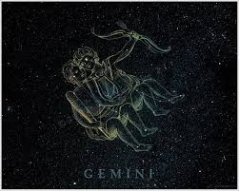
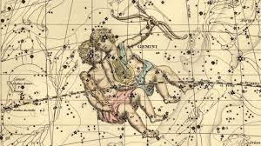
5.GEMINI ‘THE TWINS’
Gemini is one of the constellations of the zodiac. It was one of the 48 constellations described by the 2nd century AD astronomer Ptolemy and it remains one of the 88 modern constellations today. Its name is Latin for "twins," and it is associated with the twins Castor and Pollux in Greek mythology. Its symbol is.

Slide 12

Seasonal Constellations
Spring Constellation
Autumn Constellation
Summer Constellations
Winter Constellations

Slide 13
Spring Constellation
Spring constellations are the constellations that are best seen in the evening night sky from late March to late June in the northern hemisphere and from late September to late December in the southern hemisphere.
Can be seen from tropical latitudes north of the equator, but are invisible to observers living north of latitudes 25°N and 20°N respectively.

Slide 14
Autumn Constellation
Autumn constellations are the constellations that are best observed in the night sky from late September to late December in the northern hemisphere and from late March to late June in the southern hemisphere.
Autumn is a good time to see a number of notable constellations.

Slide 15

Summer Constellation
Summer constellations are the constellations that are best seen in the evening night sky from late June to late September in the northern hemisphere and from late December to late March in the southern hemisphere.
For northern observers, these are the three constellations whose brightest stars along with the southern zodiac constellations Sagittarius and Scorpius.

Slide 16
Winter Constellations
Winter constellations are the constellations that are best observed in the evening night sky from late December to late March in the northern hemisphere and from late June to late September in the southern hemisphere.

Slide 17

List of the 88 constellations recognized by the International Astronomical Union.
1. Andromeda – the Chained Maiden
2. Antlia – the Air Pump
3. Apus – the Bird of Paradise
4. Aquarius – the Water Carrier
5. Aquila – the Eagle
6. Ara – the Altar
7. Aries – the Ram
8. Auriga – the Charioteer
9. Boötes – the Herdsman
10. Caelum – the Chisel
11. Camelopardalis – the Giraffe
12. Cancer – the Crab
13. Canes Venatici – the Hunting Dogs
14. Canis Major – the Big Dog
15. Canis Minor – the Small Dog
16. Capricornus – the Sea Goat
17. Carina – the Keel of the Argo Navis
18. Cassiopeia – the Queen
19. Centaurus – the Centaur
20. Cepheus – the King
21. Cetus – the Whale
22. Chamaeleon – the Chameleon
23. Circinus – the Compass
24. Columba – the Dove
25. Coma Berenices – Berenice’s Hair
26. Corona Australis – the Southern Crown
27. Corona Borealis – the Northern Crown
28. Corvus – the Raven
29. Crater – the Cup
30. Crux – the Southern Cross

Slide 18
31. Cygnus – the Swan
32. Delphinus – the Dolphin
33. Dorado – the Dolphinfish
34. Draco – the Dragon
35. Equuleus – the Little Horse
36. Eridanus – the Celestial River
37. Fornax – the Furnace
38. Gemini – the Twins
39. Grus – the Crane
40. Hercules – the Strong Man
41. Horologium – the Pendulum Clock
42. Hydra – the Water Serpent
43. Hydrus – the Water Snake
44. Indus – the Indian
45. Lacerta – the Lizard
46. Leo – the Lion
47. Leo Minor – the Little Lion
48. Lepus – the Hare
49. Libra – the Scales
50. Lupus – the Wolf
51. Lynx – the Lynx
52. Lyra – the Harp
53. Mensa – the Table Mountain
54. Microscopium – the Microscope
55. Monoceros – the Unicorn
56. Musca – the Fly
57. Norma – the Level
58. Octans – the Octant
59. Ophiuchus – the Serpent Holder
60. Orion – the Great Hunter

Slide 19

61. Pavo – the Peacock
62. Pegasus – the Winged Horse
63. Perseus – the Greek Hero
64. Phoenix – the Firebird
65. Pictor – the Painter’s Easel
66. Pisces – the Fishes
67. Piscis Austrinus – the Southern Fish
68. Puppis – the Stern of the Argo Navis
69. Pyxis – the Compass of the Argo Navis
70. Reticulum – the Reticle
71. Sagitta – the Arrow
72. Sagittarius – the Archer
73. Scorpius – the Scorpion
74. Sculptor – the Sculptor’s Tool
75. Scutum – the Shield
76. Serpens – the Serpent
77. Sextans – the Sextant
78. Taurus – the Bull
79. Telescopium – the Telescope
80. Triangulum – the Triangle
81. Triangulum Australe – the Southern Triangle
82. Tucana – the Toucan
83. Ursa Major – the Big Bear
84. Ursa Minor – the Small Bear
85. Vela – the Sails of the Argo Navis
86. Virgo – the Young Maiden
87. Volans – the Flying Fish
88. Vulpecula – the Little Fox

Slide 20
The constellations are sometimes grouped in families based on the circumstances behind their name.

Slide 21

URSA MAJOR FAMILY
Ursa Major, Ursa Minor, Draco, Canes Venatici, Boötes, Coma Berenices, Corona Borealis, Camelopardalis, Lynx, Leo Minor
PERSEUS FAMILY
Cassiopeia, Cepheus, Andromeda, Perseus, Pegasus, Cetus, Auriga, Lacerta, Triangulum
HERCULES FAMILY
Hercules, Sagitta, Aquila, Lyra, Cygnus, Vulpecula, Hydra, Sextans, Crater, Corvus, Ophiuchus, Serpens, Scutum, Centaurus, Lupus, Corona Australis, Ara, Triangulum Australe, Crux
ORION FAMILY
Orion, Canis Major, Canis Minor, Lepus, Monoceros

Slide 22

ZODIAC FAMILY
Aries, Taurus, Gemini, Cancer, Leo, Virgo, Libra, Scorpius, Sagittarius, Capricornus, Aquarius, Pisces
HEAVENLY WATERS FAMILY
Delphinus, Equuleus, Eridanus, Piscis Austrinus, Carina, Puppis, Vela, Pyxis, Columba
JOHANN BAYER FAMILY
Hydrus, Dorado, Volans, Apus, Pavo, Grus, Phoenix, Tucana, Indus, Chamaeleon, Musca
LACAILLE FAMILY
Norma, Circinus, Telescopium, Microscopium, Sculptor, Fornax, Caelum, Horologium, Octans, Mensa, Reticulum, Pictor, Antlia

Slide 23
Stars and its characteristic

Slide 24
STAR
A star is a luminous ball of gas, mostly hydrogen and helium, held together by its own gravity. Nuclear fusion reactions in its core support the star against gravity and produce photons and heat, as well as small amounts of heavier elements. The Sun is the closest star to Earth.

Slide 25
10 TYPES OF STARS

Slide 26
1. YELLOW DWARFS STARS
G-type stars are often mistakenly referred to as yellow dwarf stars. Our Sun is an example of a G-type star, but it is in fact white, since all the colors it emits are blended together.
Typical G-type stars have between 0.84 and 1.15 solar masses, and temperatures that fall into a narrow range of between 5,300K and 6,000K. Like the Sun, all G-type stars convert hydrogen into helium in their cores.

Slide 27
2. ORANGE DWARF STARS
Orange dwarf stars are K-type stars, fall between red M-type stars and yellow G-type stars. K-type stars are of particular interest in the search for extraterrestrial life, since they emit markedly less UV radiation, and they remain stable on the main sequence for up to about 30 billion years, as compared to about 10 billion years for the Sun.

Slide 28
3. RED DWARFS STAR
Red dwarfs account for the bulk of the Milky Ways’ stellar population, but since they are very faint, no red dwarf stars are visible without optical aid. Typically, red dwarf stars that are more massive than 0.35 solar masses are fully convective, which means that the process of converting hydrogen into helium occurs throughout the star, and not only in the core, as is the case with more massive stars.

Slide 29
4.BROWN DWARF STARS
Also commonly referred to as “failed stars”, brown dwarfs are sub-stellar objects that fill the gap between the most massive gas planets, and the least massive true stars. Typically, brown dwarf stars fall into the mass range of 13 to 80 Jupiter-masses, with sub-brown dwarf stars falling below this range
While brown dwarf stars are not massive enough to initiate and sustain a process of converting hydrogen into helium in their cores.

Slide 30
5.BLUE GIANT STAR
The term “blue giant star” has no scientific definition, and is commonly applied to a wide variety of stars that have all evolved off the main sequence. However, for practical reasons, stars with luminosity classifications of III and II (bright giant and giant) respectively, are referred to as “blue giant stars” purely for convenience, but only when that stars is hot enough to be called a blue star, which is usually above around 10,000K. Nonetheless, the term blue giant is often mis-applied to some stars simply because they are big and hot.

Slide 31
6.RED GIANTS STAR
Red giant stars are smaller and less massive that red super giants, generally weighing in at between 0.3 to 8 solar masses. Most common hydrogen is still being fused into helium, but in a shell around an inert helium core. Other types of red giant stars include the red-clump stars.

Slide 32
7.RED SUPERGIANTS
Red supergiant stars are stars that have exhausted their supply of hydrogen at their cores, and as a result, their outer layers expand hugely as they evolve off the main sequence. Stars of this type are among the biggest stars known in terms of sheer bulk, although they are generally not among the most massive or luminous.

Slide 33
8. WHITE DWARFS
White dwarf stars are the cores of low and intermediate mass (typically lower than 3 solar masses) stars that have blown off their outer layers late in their lives. These stellar remnants no longer produce energy to counteract their mass, and are supported against gravitational collapse by a process called electron degeneracy pressure.

Slide 34

9. BLACK DWARFS
Black Dwarfs are hypothetical stars that are theorised to be white dwarfs that have radiated away all their leftover heat and light. However, white dwarfs live for an extremely long period of time, with many of the ones detected so far being in excess of 10 billion years, meaning that no black dwarfs have had enough time to form in the Universe’s 13.8 billion year history

Slide 35
10.NEUTRON STARS
Neutron stars are the collapsed cores of massive stars (between 10 and 29 solar masses) that were compressed past the white dwarf stage during a supernova event. In this state, the entire mass of the stellar remnant consists of neutrons, particles that are marginally more massive than protons, but carry no electrical charge. Neutron stars are supported against their own mass by a process called “neutron degeneracy pressure”, but the process of gravitational collapse into a black hole may continue if the remnant has more than 3 solar masses.

Slide 36
A LIFE CYCLE OF A STAR

Slide 37

Stars are formed in clouds of gas and dust, known as nebulae. Nuclear reactions at the centre (or core) of stars provides enough energy to make them shine brightly for many years. The exact lifetime of a star depends very much on its size. Very large, massive stars burn their fuel much faster than smaller stars and may only last a few hundred thousand years. Smaller stars, however, will last for several billion years, because they burn their fuel much more slowly.

Slide 38
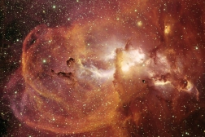
STAR FORMATION
Stars are formed, or are "born", in large clouds of gas and dust. The cloud slowly shrinks and then starts to collapse onto a number of points (or cores) within the cloud, all due to the pull of gravity.
Right in the middle of these cores, it can get very hot and dense. When this happens, nuclear fusion can start and a star is born. This is called stellar ignition.
The sudden burst of light made by the new star blows away much of the nearby gas cloud, but it can leave just enough material behind to form a number of planets later on.
You can see what is happening in a bit more detail in this simulation.

Slide 39
THANK YOU

